Slide 1



DEFORESTATION – FIRE CLASSIFICATION
NAME : KUMARI SWATI VERMA
EMAIL: mail.swati.dev@gmail.com
AICTE INTERNSHIP STUDENT REGISTRATION ID :
STU67d9b5c3053601742321091

Slide 2

Learning Objectives
1.Understand the role of satellite data in detecting and classifying fire incidents.
2.Learn how to preprocess and analyze large geospatial datasets.
3.Apply machine learning models for multi-class classification tasks.
4.Develop and deploy a predictive model as a web-based API.
5.Interpret model evaluation metrics for performance analysis.
GOAL

Slide 3
Tools and Technology used
Programming Language​
Python –Used for data processing, model training, evaluation, and backend API development.
Machine Learning
Scikit-learn – Provided machine learning algorithms (Random Forest, SVM), model evaluation metrics, and GridSearchCV for tuning.
Data Processing & Analysis​
NumPy & Pandas — Used for data cleaning, transformation, and analysis.
Matplotlib & Seaborn — Used to visualize data patterns, feature importance, and confusion matrix.​
Model Deployment
Flask – Used to build a lightweight API for real-time fire type prediction. Joblib – Used to serialize and load the trained model.
Dataset
MODIS Satellite Fire Data (From Kagglehub)– Provided labeled fire incident records across India with spatial and intensity features.
Additional Tools​ - Google Colab – Cloud-based Jupyter environment.​
​
​

Slide 4
Methodology
1.Data Collection: Acquired MODIS satellite fire data with labels like brightness, confidence, latitude, and fire type.
2.Preprocessing: Handled missing values, normalized features, and encoded categorical variables. Split data for training and testing.
3.Model Training: Used Scikit-learn to train Random Forest, SVM, and Logistic Regression. Tuned hyperparameters and selected the best model.
4.Evaluation: Assessed model using Accuracy, Precision, Recall, F1 Score, and confusion matrix.
5.Deployment: Saved model using Joblib and deployed it using Flask to serve real-time predictions via API.

Slide 5
Problem Statement:
Uncontrolled fires—whether in forests, agricultural land, or other areas—pose serious threats to the environment, public health, and local economies.
Despite the availability of satellite-based fire detection data, there is a lack of effective systems to automatically classify fire types in real time.
Manual analysis is slow and often delayed, limiting timely response and resource deployment.
There is a need for an intelligent system that can classify fire incidents based on satellite data and support rapid decision-making.
Objective
The main objective of this project is to develop an intelligent system that classifies fire types in India using MODIS satellite data, enabling quicker response and better resource allocation.

Slide 6
Solution:
To address the challenge of fire type identification, we utilized machine learning techniques on MODIS satellite data. The solution involved the following key steps:
1.Preprocessed satellite fire data by cleaning, normalizing, and encoding features.
2.Trained and compared multiple classifiers (Random Forest, SVM, Logistic Regression).
3.Selected Random Forest based on superior accuracy and robustness.
4.Deployed the trained model using Flask as an API, allowing real-time prediction of fire types based on input features.
5.Enabled the system for potential integration into fire monitoring and emergency response platforms.

Slide 7
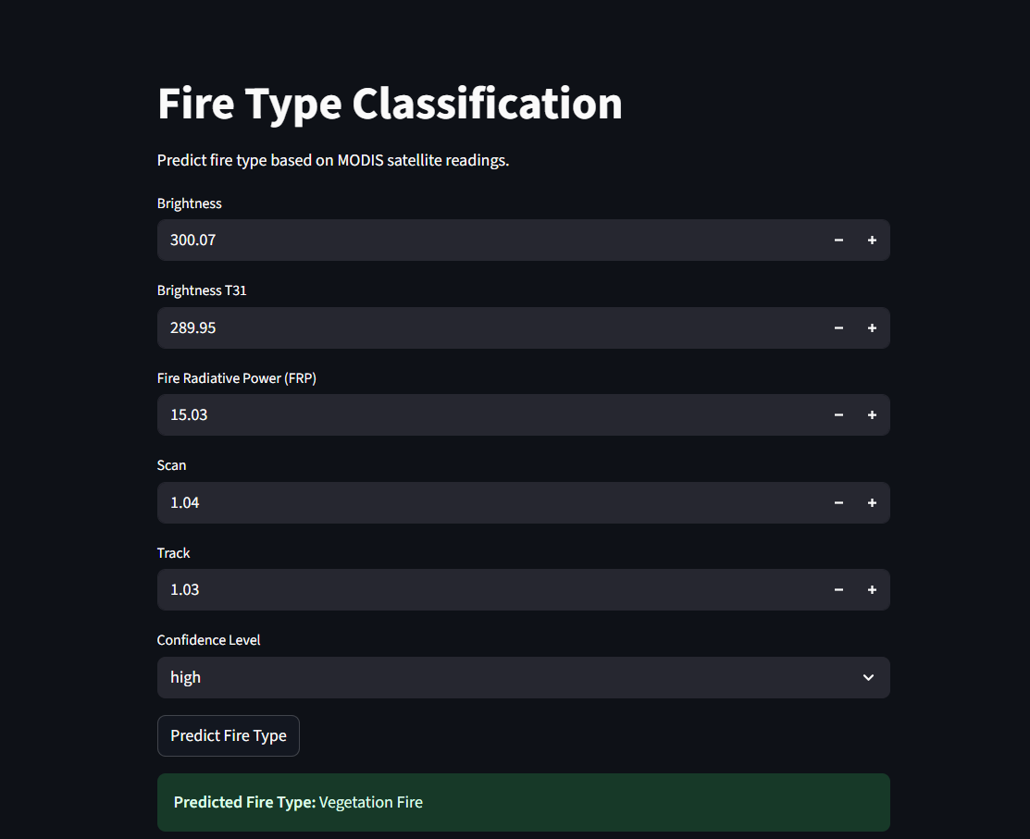
Screenshot of Output:

Slide 8
Conclusion:
Successfully developed a machine learning model to classify fire types in India using MODIS satellite data.
Random Forest classifier achieved high accuracy and was chosen as the final model.
The model was deployed using Flask to serve predictions in real time via a web API.
The solution demonstrates how satellite data and ML can assist in proactive fire management.
With further enhancement, the system can be integrated into national disaster response or environmental monitoring systems.

